Slide 1
6G4Z0024 Web Development Lecture 5: DOM Scripting
Yanlong Zhang
Y.Zhang@mmu.ac.uk

Slide 2
Learning Objectives
To understand Document Objective Model
To understand DOM queries
To understand the DOM scripting

Slide 3
Last week recap
CSS – responsive design
* Usability and accessibility
JS – link js with html
data type: number, string, object, array
function

Slide 4
DOM Scripting: Document Object Model

Slide 5
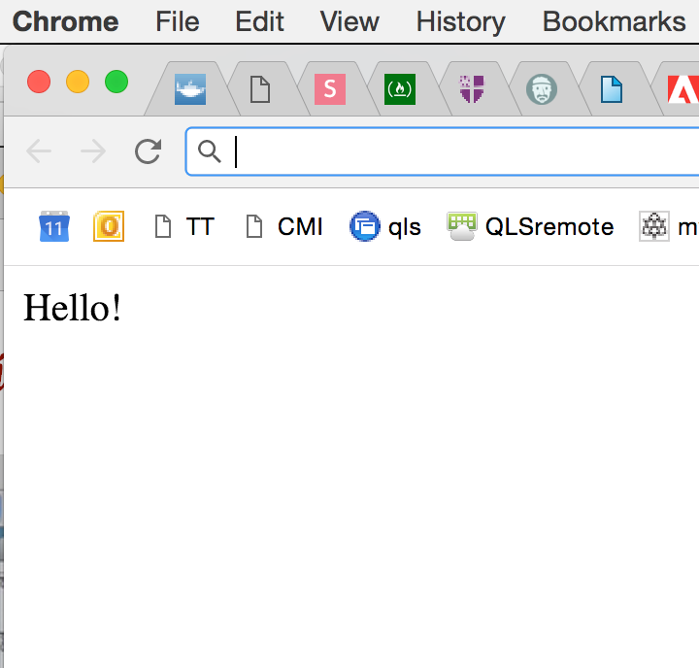

Don’t write to the page..
document.write (“Hello!”) ;

Slide 6
..use the DOM instead
the document is the entry point into the content of the page loaded in the browser
Manipulate the child nodes of the Document Object Model

Slide 7
JS: Document Object Model (DOM)
DOM stands for Document Object Model, and allows programmers generic access to:
adding, deleting, and manipulating - of all styles, attributes, and elements in a document.
It can be accessed via any language available in the browser, including Java, JavaScript/ECMAScript/JScript, and VBScript (MSIE only).
The DOM is supported most completely starting in IE 5 and Gecko (NS6 and upwards, such as Firefox.)
Every tag, attribute, style, and piece of text is available to be accessed and manipulated via the DOM -- the possibilities are endless:
adding and removing tags,
attributes and styles,
animating existing elements,
and hiding/ showing elements on a page.

Slide 8
JS: Document Object Model (DOM)
The DOM is constantly being revised by the W3C, with browsers at the same time constantly trying to support the latest recommended version of the DOM.
From IE6 and Firefox 1.0, DOM 2 best encompasses what the two browsers currently support.
DOM 3 is the next major version in the works.
Before we get started, you need to know a few terms that we will use:
Node: A reference to an element.
Element: A representation of a <TAG>.
Attribute: A property of an element. HREF is an attribute of <A>, for example.

Slide 9
JS: Document Object Model (DOM)
The DOM represent an HTML documents as a tree of objects.
The tree representation of an HTML document contains nodes representing HTML tags or elements, such as <body> and <p>, and nodes representing strings of text.
An HTML document may also contain nodes representing HTML comments.

Slide 10
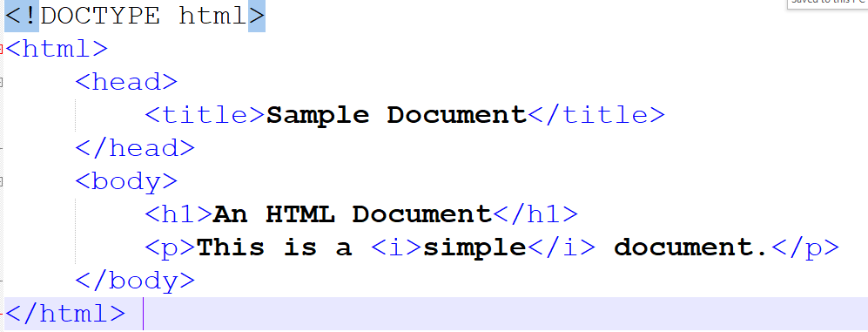
JS: Document Object Model (DOM)
Consider the following simple HTML document:

Slide 11
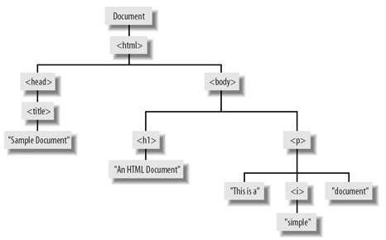
JS: Document Object Model (DOM)
The tree representation of the previous HTML document:

Slide 12
Nodes relationships
<html> is the root node
<html> has no parents
<html> is the parent of <head> and <body>
<head> is the first child of <html>
<body> is the last child of <html>
<head> has one child: <title>
<title> has one child
<body> has two children: <h1> and <p>
<h1> has one child:
<p> has one child: "Hello world!"
<h1> and <p> are siblings

Slide 13
JS: Document Object Model (DOM)
The DOM says that:
The entire document is a document node
Every HTML tag is an element node
The texts contained in the HTML elements are text nodes
Every HTML attribute is an attribute node
Comments are comment nodes

Slide 14
Create dynamic HTML
JavaScript can change all the HTML elements in the page
JavaScript can change all the HTML attributes in the page
JavaScript can change all the CSS styles in the page
JavaScript can remove existing HTML elements and attributes
JavaScript can add new HTML elements and attributes
JavaScript can react to all existing HTML events in the page
JavaScript can create new HTML events in the page

Slide 15
<ul> <li></li> <li></li> <li></li> <li></li> </ul>
ELEMENT NODES
ul
li
li
li
li

Slide 16
<ul> <li>fresh figs</li> <li>pine nuts</li> <li>honey</li> <li>balsamic vinegar</li> </ul>
TEXT NODES
ul
li
li
li
li
text
text
text
text

Slide 17
<ul> <li id=“one” class=“hot”>fresh figs</li> <li id=“two” class=“hot”>pine nuts</li> <li id=“three” class=“hot”>honey</li> <li id=“four”>balsamic vinegar</li> </ul>
ATTRIBUTE NODES
ul
li
attribute
li
attribute
li
attribute
li
attribute
text
text
text
text

Slide 18
To access and update the HTML, first you select the element(s) you want to work with.

Slide 19
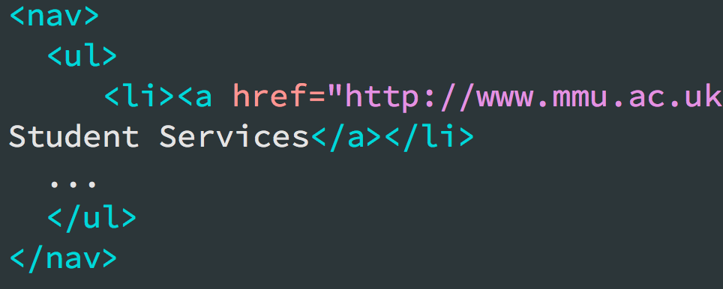
Remember css?
nav ul li
{
list-style-type: none;
}
CSS Selectors:
tag name => tag name
id => #id
class => .class

Slide 20
Here are some of the ways ways to select element nodes with JavaScript. They are known as DOM queries.

Slide 21
DOM QUERIES
getElementById()
getElementsByClassName()
getElementsByTagName()
querySelector()
All return HTML element objects

Slide 22
getElementById(‘one’);
<ul> <li id=“one” class=“hot”>fresh figs</li> <li id=“two” class=“hot”>pine nuts</li> <li id=“three” class=“hot”>honey</li> <li id=“four”>balsamic vinegar</li> </ul
ul
li
li
li
li

Slide 23
getElementsByClassName(‘hot’);
<ul> <li id=“one” class=“hot”>fresh figs</li> <li id=“two” class=“hot”>pine nuts</li> <li id=“three” class=“hot”>honey</li> <li id=“four”>balsamic vinegar</li> </ul
ul
li
li
li
li

Slide 24
getElementsByTagName(‘li’);
<ul> <li id=“one” class=“hot”>fresh figs</li> <li id=“two” class=“hot”>pine nuts</li> <li id=“three” class=“hot”>honey</li> <li id=“four”>balsamic vinegar</li> </ul
ul
li
li
li
li

Slide 25
querySelector(‘ul’);
<ul> <li id=“one” class=“hot”>fresh figs</li> <li id=“two” class=“hot”>pine nuts</li> <li id=“three” class=“hot”>honey</li> <li id=“four”>balsamic vinegar</li> </ul
ul
Li
li
li
li

Slide 26
querySelector(‘#two’);
<ul> <li id=“one” class=“hot”>fresh figs</li> <li id=“two” class=“hot”>pine nuts</li> <li id=“three” class=“hot”>honey</li> <li id=“four”>balsamic vinegar</li> </ul
ul
li
li
li
li

Slide 27
JS: DOM content innerHTML
innerHTML sets or gets all of the markup and content within a given element.
let markup = element.innerHTML; element.innerHTML = markup;
Creating <p>Some text</p>
let para = document.createElement(“p”);
para.innerHTML = “Some text”; //able to include html tag
para.innerHTML = “Some <em>text</em>”;
document.body.appendChild(para);

Slide 28
Example
<html> <body> <p id="demo"></p> <script> document.getElementById("demo").innerHTML = "Hello World!"; </script> </body> </html>

Slide 29
DOM Events
A JavaScript can be executed when an event occurs, like when a user clicks on an HTML element.
To execute code when a user clicks on an element, add JavaScript code to an HTML event attribute
<!DOCTYPE html> <html> <body> <h1 onclick="this.innerHTML = 'Ooops!'">Click on this text!</h1> * </body> </html>
* DOM 1, not recommended

Slide 30
DOM animation
<!DOCTYPE html>
<html>
<style>
#container {
width: 400px;
height: 400px;
position: relative;
background: yellow;
}
#block {
width: 50px;
height: 50px;
position: absolute;
background-color: blue;
}
</style>
<body>
<p><button onclick="myMove()">Click Me</button></p> *
<div id ="container">
<div id =“block"></div>
</div>
* DOM 1, not recommended

Slide 31
<script>
function myMove() {
let block = document.getElementById(“block");
let pos = 0;
let id = setInterval(frame, 5);
function frame() {
if (pos == 350) {
clearInterval(id);
} else {
pos++;
block.style.top = pos + "px";
block.style.left = pos + "px";
}
}
}
</script>
</body>
</html>

Slide 32
Lab Ex3.1.html
<!DOCTYPE html>
<html>
<head>
<meta charset=’utf-8’>
<title>JS DOM 1</title>
</head>
<body>
<p id=’change’> I am John </p>
<button id=’changeContent’ >Change</button>
<script src=’dom.js’></script>
</body>
</html>

Slide 33
Document Objects
The webpage, the document, and everything in it…are all Objects
Objects use properties and methods.

Slide 34
Properties tell the computer about the characteristics of an object.

Slide 35
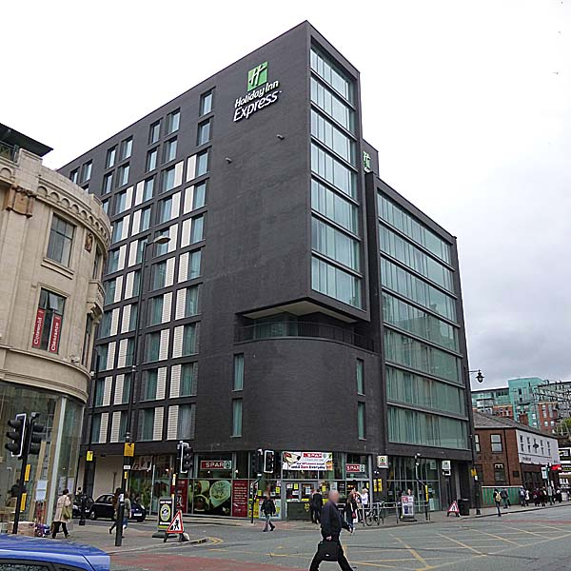
OBJECT TYPE: HOTEL
PROPERTIES
name Holiday Inn
rating 4*
rooms 147
bookings 21
gym false
pool false
address 2-4 Oxford Rd

Slide 36
Methods tell the object how to do things with it

Slide 37
OBJECT TYPE: HOTEL
METHOD what it can do:
makeBooking() increases value of bookings PROPERTY
cancelBooking() decreases value of bookings property
checkAvailability() subtracts value of bookings property from value of rooms property and returns number of rooms available

Slide 38
A car as an object:

Slide 39
Webpage Objects
Have various properties and methods
Use reference source to find out properties and methods
Example
<video width=“640" height=“480" poster=‘./images/poster.jpg’> <source src="movie.mp4" type="video/mp4"> <source src="movie.ogg" type="video/ogg"> Your browser does not support the HTML5 video tag. </video>
Properties: width; height; poster
Methods: play(pause) video; stop video; FF/RW video;……

Slide 40
In your JavaScript file..
Get from the .html document the element(s) you want to work with

Slide 41
e.g. 1: getElementById()
HTML source:
<button type="button" id="playPause" >Play </button>
JavaScript:
Associates HTML element with JavaScript variable

Slide 42

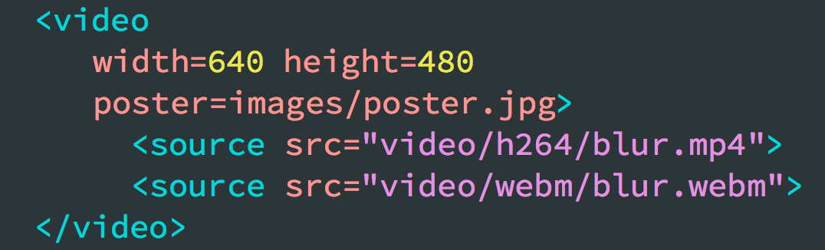
e.g. 2: querySelector()
HTML source:
JavaScript:

Slide 43
Next:
..then change a property or call a method

Slide 44
Lab sessions
JS programming
DOM exercises

